Slide 1
YOLOv8 Object Detection: INTRODUCTION
Wireless Artificial Intelligence (WAI) Lab
Doan Hieu Nguyen
Subject: Deep learning for computer vision
Mentor: Prof. DoHoon Lee
Wednesday, 22nd November 2023

Slide 2
OUTLINE
1.
Computer Vision and Object Detection
2.
You Only Look Once (YOLO)
3.
YOLOv8
4.
Application
5.
Conclusion

Slide 3
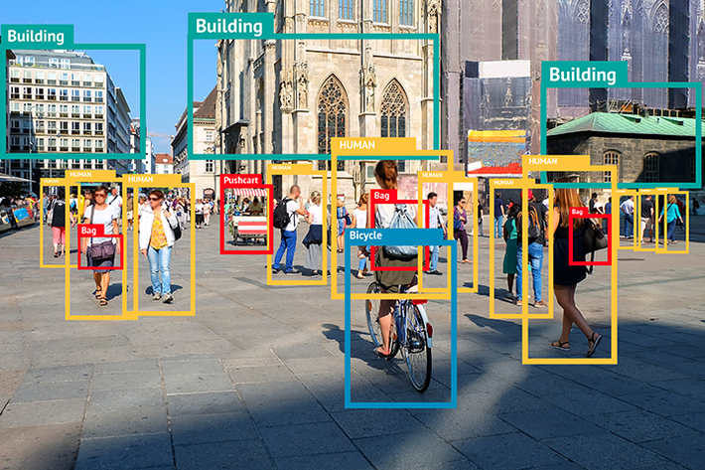
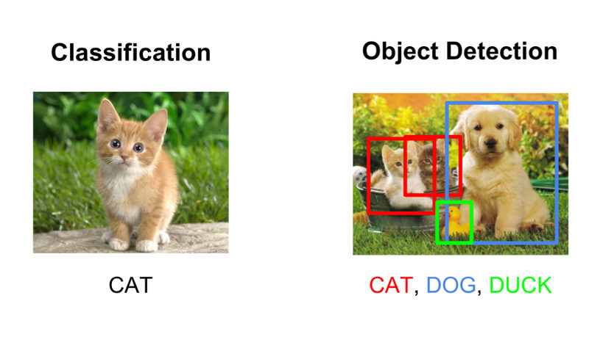
Object Detection
★
What is Computer Vision
Enable Machines to interpret and understand visual information from the world
Ultimate goal is to replicate human vision abilities.
★
What is Object Detection
A specific task within computer vision, focus on locating and classifying objects.
Different from Image Classification.
Output includes bounding boxes, detected objects and their labels.

Slide 4
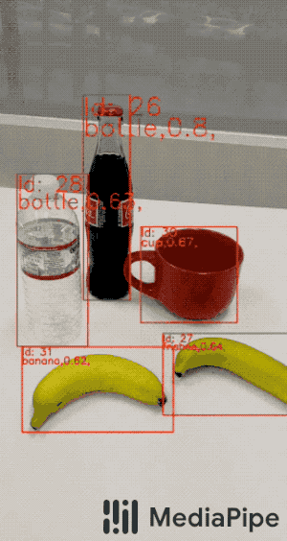
Object Detection
★
Key Aspects of Object Detection
Bounding Boxes: the pattern predicted belong to the object
Class Labels: not only locating objects but also assigning class labels to them
Real-time Processing: allow systems to process images or video frames rapidly, making it suitable for applications like surveillance and autonomous vehicles
Deep Learning Model: apply deep learning techniques, such as CNN, RNN, ANN … to improve the performance
Notes:
In the last few years, the rapid advances in deep learning techniques have greatly accelerated the momentum of object detection technology. With deep learning networks and the computing power of GPUs, the performance of object detectors and trackers has greatly improved, achieving significant breakthroughs in object detection.

Slide 5
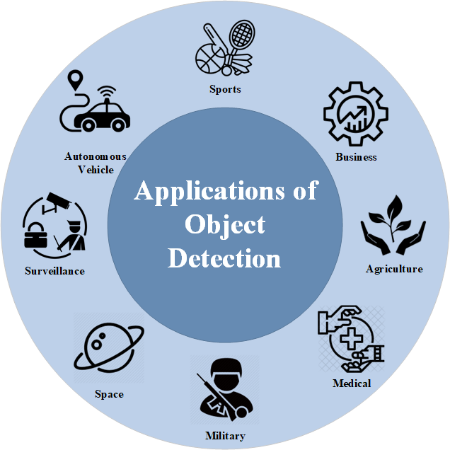
Object Detection
★
Application of Object Detection
Autonomous Vehicles: identify and tracking road sign, pedestrians, other vehicles and obstacles
Medical Purpose: tumor detection, organ segmentation
Retail and Inventory Management: analyzing custom behavior …
Environmental Monitoring
Smart Cities
Notes:
In the last few years, the rapid advances in deep learning techniques have greatly accelerated the momentum of object detection technology. With deep learning networks and the computing power of GPUs, the performance of object detectors and trackers has greatly improved, achieving significant breakthroughs in object detection.

Slide 6
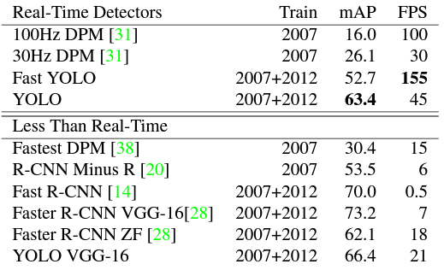
You Only Look Once (YOLO)
★
What is YOLO?
An end-to-end approach to object detection that allowed for real-time processing
A significant development for computer vision community
Single pass through neural network
Grid-based Prediction
Bounding Box Prediction
Class Prediction
Multi-scale Detection
Notes:
Prior detection system repurpose classifiers or localizers to perform detection. They apply the model to an image at multiple locations and scales. High scoring regions of the image are considered detections. YOLO use totally different approach, it applies a single NN to full image. This network divide the image into regions and predicts bounding boxes and probabilities for each region. These bounding boxes are weighted by the predicted probabilities

Slide 7
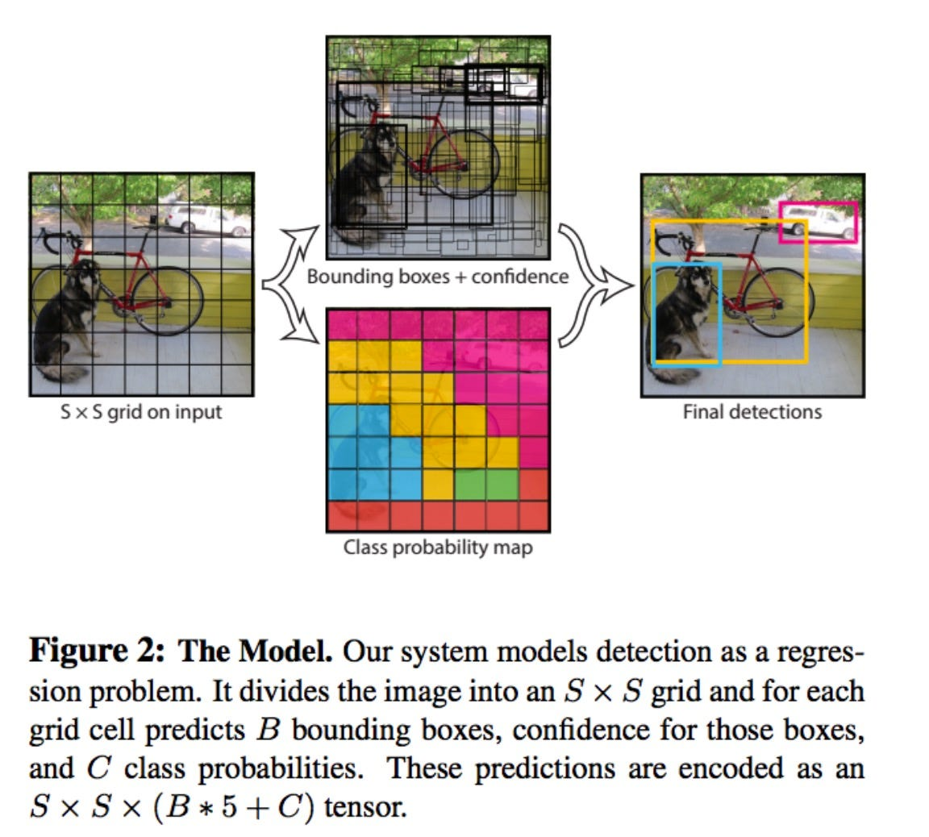
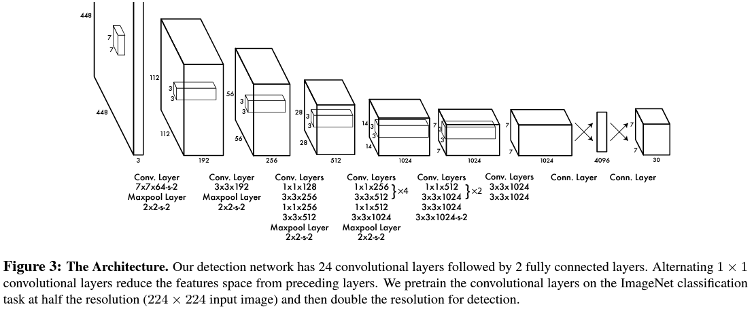
You Only Look Once (YOLO)
★
YOLO Architecture
Backbone: CNN layers, vary between different version
Grid Division
Bounding Boxes
Class Prediction
Object Confidence Score
Non-Maximum Suppression
Notes:
Backbone: feature extraction, in the first version, it contains multiple convolutional layers. After YOLOv4, backbone model can be VGG, ResNet, SpineNet…
Neck: additional layers between backbone and the head to add extra information in the layers
Head: final part to locate bounding boxes and classify the label
It uses Darknet Network. Split input image into a grid of SxS cells, each grid cell predicts B number of bounding boxes and their object score along with their class prediction. Coordinates of B bounding boxes – YOLO predicts 4 coordinates for each bounding box with respect to the corresponding grid cell

Slide 8
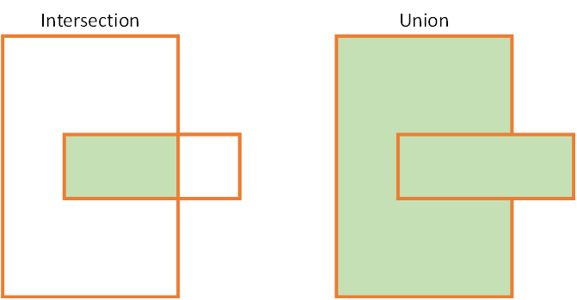
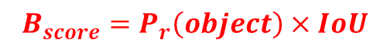
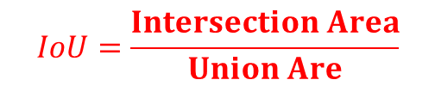

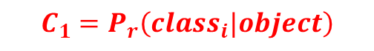
You Only Look Once (YOLO)
★
Box Confidence Score: probability the box contains an object and how accuracy of the boundary box.
$$B_{score}=P_{r}\left(object\right)×IoU$$
★
Conditional class probabilities: probability that the detected objects belongs to a specific class.
$$C_{1}=P_{r}\left(class_{i}|object\right)$$
★
Class confidence score:
$$C_{2}=B_{score}×C_{1}$$
★
Intersection over Union (IOU):
$$IoU=\frac{Intersection Area}{Union Are}$$
Notes:
https://towardsdatascience.com/object-detection-part1-4dbe5147ad0a
https://www.sciencedirect.com/topics/computer-science/confidence-score
NMS intends to cure the problem of multiple detections of the same img

Slide 9
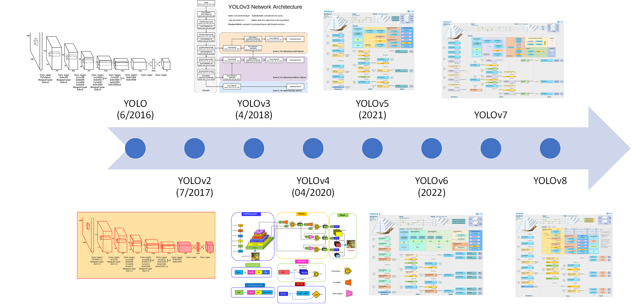
You Only Look Once (YOLO)
★
History
YOLO: fast object detector, have some limitations.
YOLOv2: improved in batch normalization, anchor boxes, dimension clusters.
YOLOv3: improve backbone network, multiple anchors and spatial pyramid pooling
YOLOv4: Mosaic data augmentation, new anchor-free detection, new loss function
YOLOv5: add new features
YOLOv6:
YOLOv7: can deal with pose estimation
YOLOv8: more flexibility and efficiency, full range of AI tasks
Notes:
YOLO (You Only Look Once), a popular object detection and image segmentation model, was developed by Joseph Redmon and Ali Farhadi at the University of Washington. Launched in 2015, YOLO quickly gained popularity for its high speed and accuracy.
YOLOv2, released in 2016, improved the original model by incorporating batch normalization, anchor boxes, and dimension clusters.
YOLOv3, launched in 2018, further enhanced the model's performance using a more efficient backbone network, multiple anchors and spatial pyramid pooling.
YOLOv4 was released in 2020, introducing innovations like Mosaic data augmentation, a new anchor-free detection head, and a new loss function.
YOLOv5 further improved the model's performance and added new features such as hyperparameter optimization, integrated experiment tracking and automatic export to popular export formats.
YOLOv6 was open-sourced by Meituan in 2022 and is in use in many of the company's autonomous delivery robots.
YOLOv7 added additional tasks such as pose estimation on the COCO keypoints dataset.
YOLOv8 is the latest version of YOLO by Ultralytics. As a cutting-edge, state-of-the-art (SOTA) model, YOLOv8 builds on the success of previous versions, introducing new features and improvements for enhanced performance, flexibility, and efficiency. YOLOv8 supports a full range of vision AI tasks, including detection, segmentation, pose estimation, tracking, and classification. This versatility allows users to leverage YOLOv8's capabilities across diverse applications and domains.

Slide 10
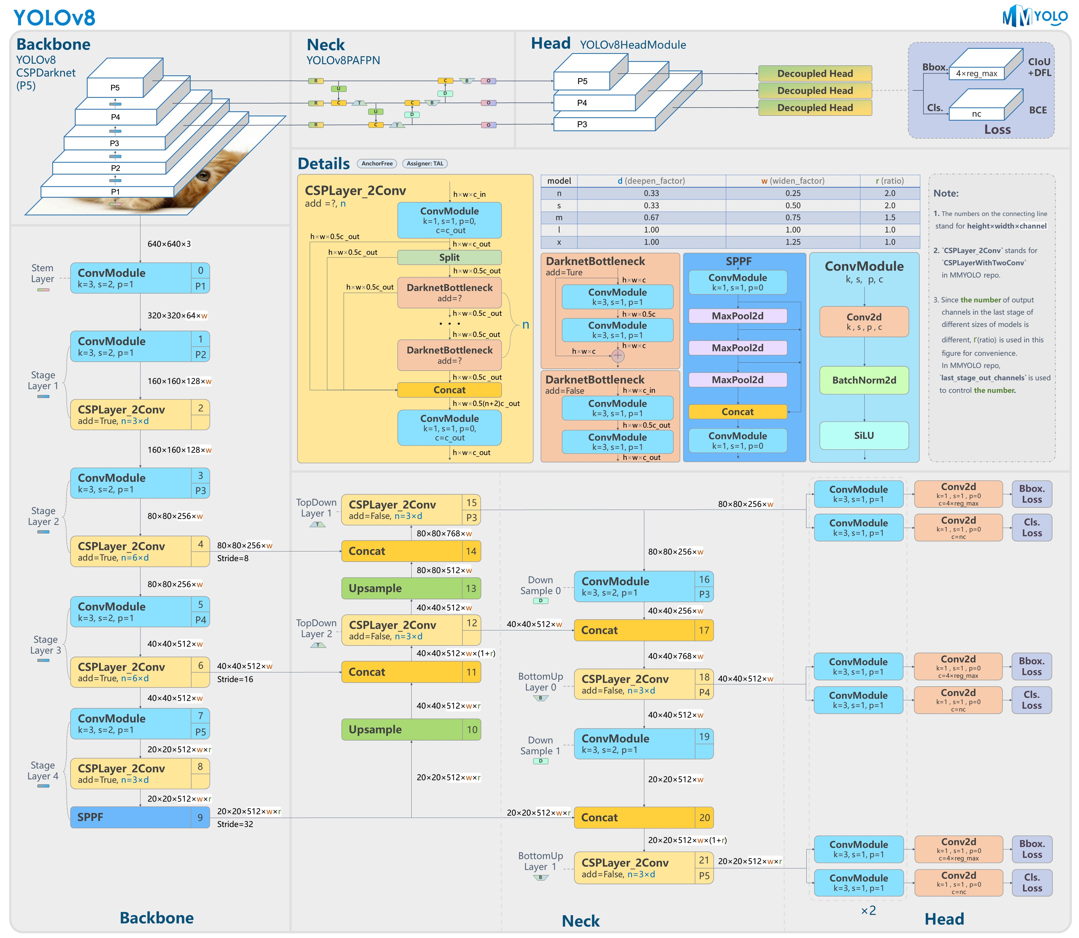
YOLOv8
★
Architecture
Anchor-free
Predicting fewer boxes
Faster Non-maximum Suppression process
Mosaic augmentation is used for training progress but it is disable for last ten epochs
New loss function
Notes:
Is YOLOv8 Open Source?
YOLOv8 is an Open Source SOTA model built and maintained by the Ultralytics team. It is distributed under the GNU General Public License, which authorizes the user to freely share, modify and distribute the software. The YOLOv8 community is vibrant and ever-growing.
Who is the Author of YOLOv8?
YOLOv8 is written and maintained by the Ultralytics team. YOLO models were initially the creation by Joseph Redmon, a Computer Scientist. He cycled through three iterations of YOLO, with the third one being YOLOv3, all written in Darknet Architecture.
Glenn Jocher shadowed YOLOv3 in PyTorch along with a few minor changes and named it YOLOv5. YOLOv5’s architecture was then modified to develop YOLOv8.
Currently, there is no paper discussing the architecture of YOLOv8, so we must rely on insights to compare it to previous versions of YOLO. YOLOv8 is anchor-free,
predicting fewer boxes and has a faster Non-maximum Suppression (NMS) process. During training, YOLOv8 uses mosaic augmentation, but this technique is disabled for the last ten epochs since it can be harmful if used throughout the entire training process.
YOLOv8 offers five different scaled versions: YOLOv8n (nano), YOLOv8s (small), YOLOv8m (medium), YOLOv8l (large), and YOLOv8x (extra-large). When tested on the MS COCO dataset test-dev 2017, YOLOv8x achieved an impressive AP of 53.9% with an image size of 640 pixels, compared to YOLOv5’s 50.7% on the same input size. Additionally, it has a fast speed.

Slide 11
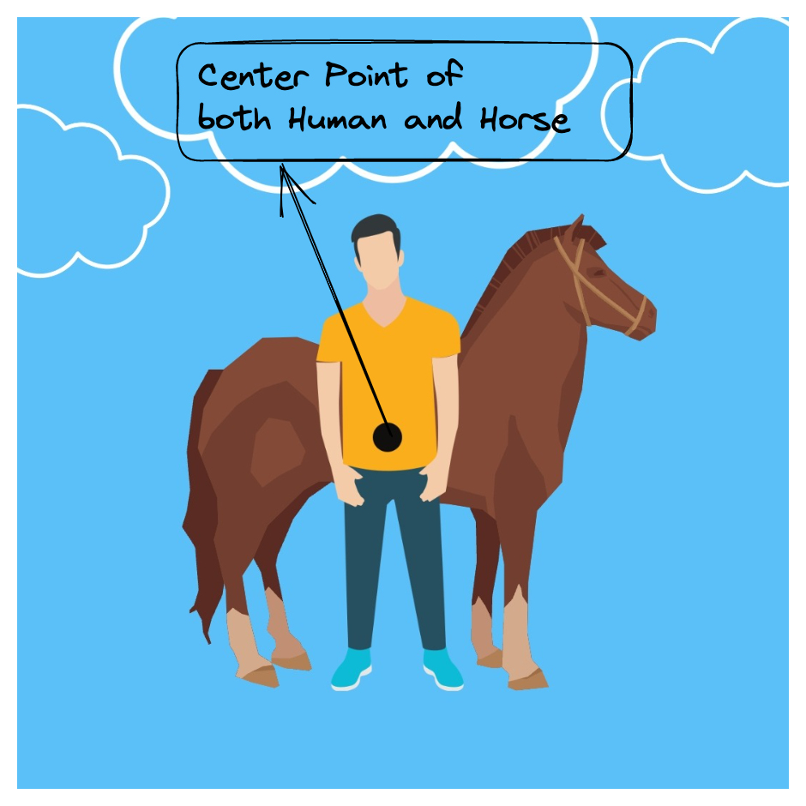
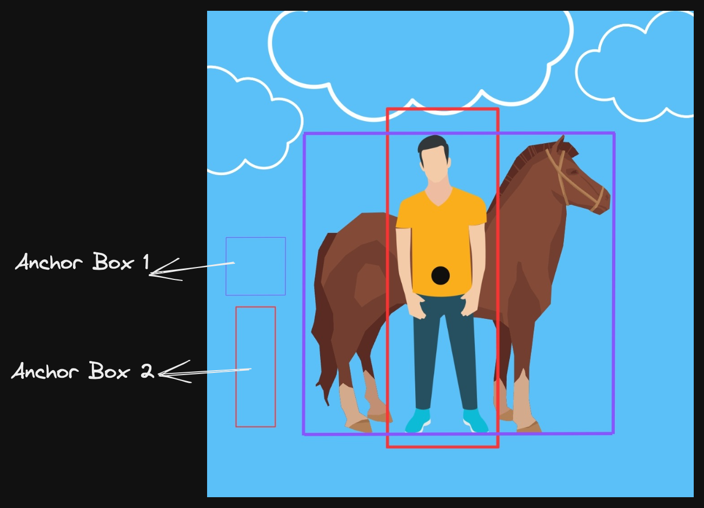
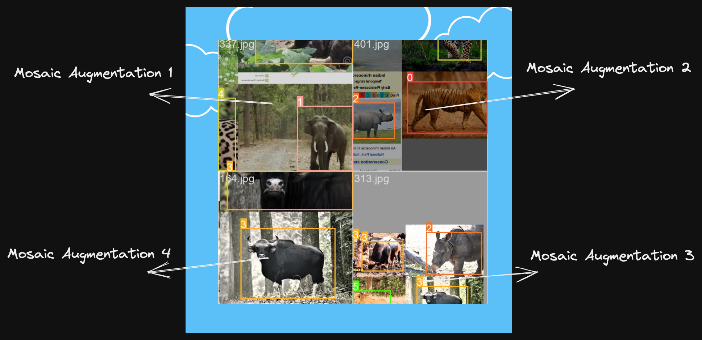
YOLOv8
★
Anchor-Free Detection
Anchor boxes detection
★
Mosaic Augmentation
Notes:
Anchor boxes solved a major problem within object detection. Before anchor boxes, an object is assigned to a grid cell that contains the given object’s midpoint. If two objects had the same center point, constructing bounding boxes and allocating them to individual classes become quite tricky. This means it predicts directly the center of an object instead of the offset from a known anchor box.

Slide 12
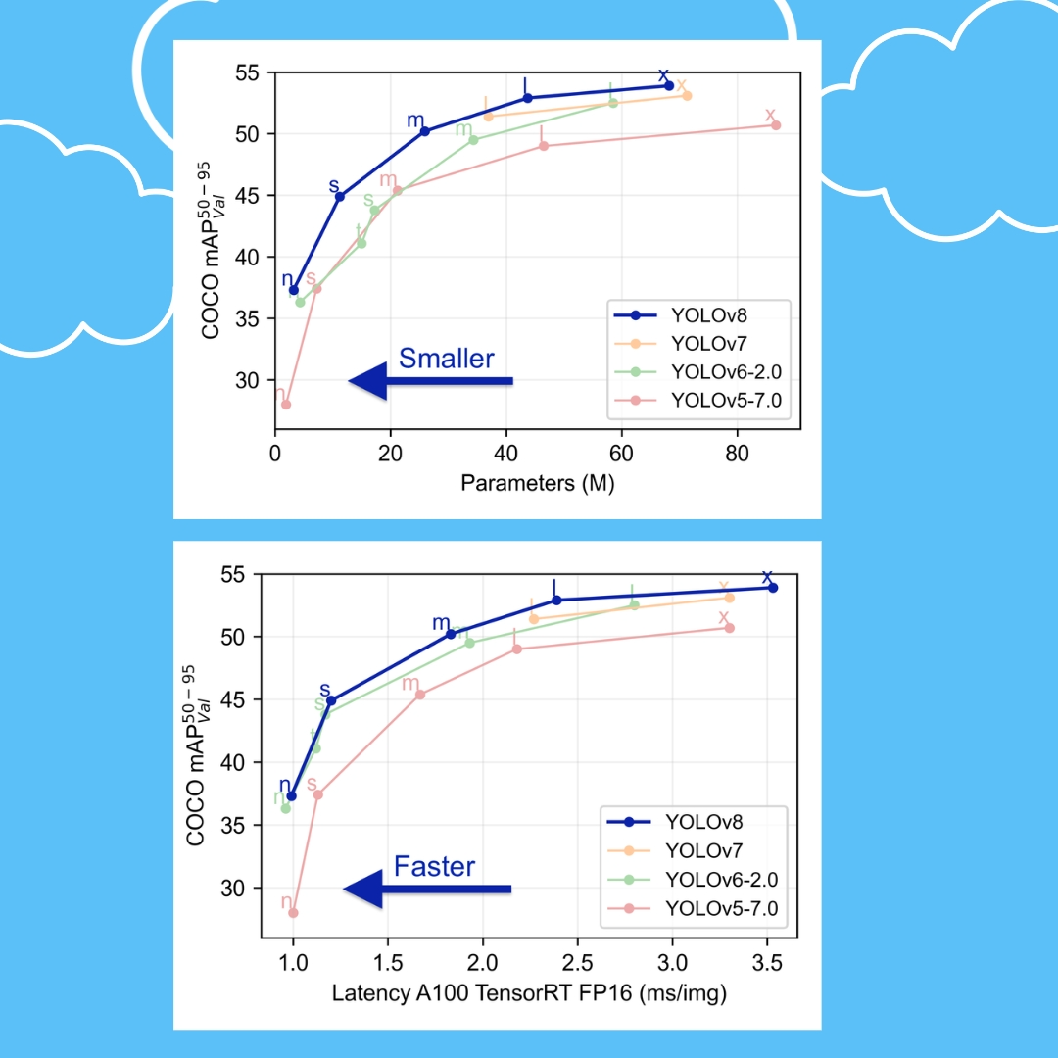

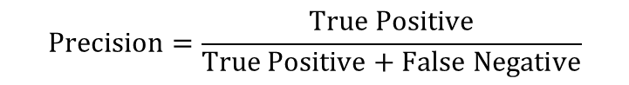
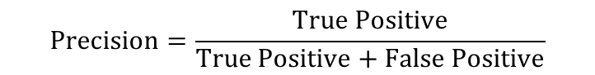
YOLOv8
★
Enhancements
Impressive speed and Accuracy
Higher Mean Average Precision (mAP)
$$Precision=\frac{True Positive}{True Positive+False Positive}$$
$$Precision=\frac{True Positive}{True Positive+False Negative}$$
$$mAP=\frac{1}{N}\sum_{i=1}^{N}{AP_{i}}$$
Notes:
The most common metric used for evaluation in an image classification problem is Precision, Recall, Confusion-matrix, PR-curve, etc. While in image segmentation, Mean Intersection over Union, aka mIoU, is used. It explain the tradeoff between precision and recall maximizes the effect of both metrics
mAP is the current benchmark metric used by the computer vision research community to evaluate the robustness of object detection models.
Precision measure how much positive prediction is correct
Recall: how much positive data is predicted correctly

Slide 13
Application
★
Classification
★
Object Detection
★
Image segmentation

Slide 14
THANK YOU

